Slide 1
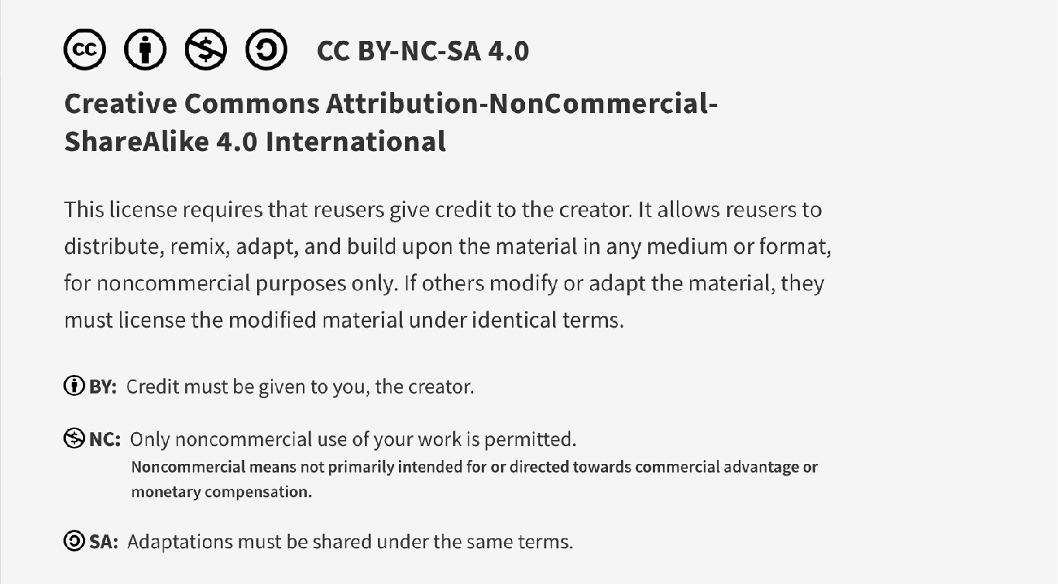
This work is licensed under CC BY-NC-SA 4.0. To view a copy of this license, visit: https://creativecommons.org/licenses/by-nc-sa/4.0/

Slide 2

Situational Awareness, Communication and Teamwork
Lucie Filteau, MD, FRCPC
PGY 2-4 Academic Half Day
QPS Series

Slide 3
Ottawa Anesthesia QPS Curriculum
PGY 1
PGY 2-4
Intro to Safety
Handover
Stress and Substance Abuse
IPAC Session
Positioning Workshop
Intro to Quality Improvement 1
Intro to Quality Improvement 2
Systems Thinking and Design
Human Factors
Resource Stewardship
Situational Awareness, Teamwork and Communication

Slide 4
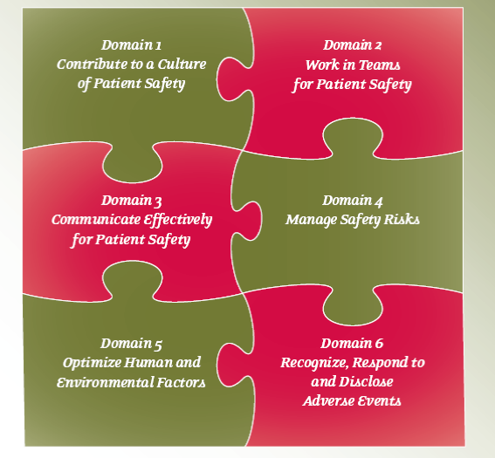
The Royal College Safety Competencies

Slide 5
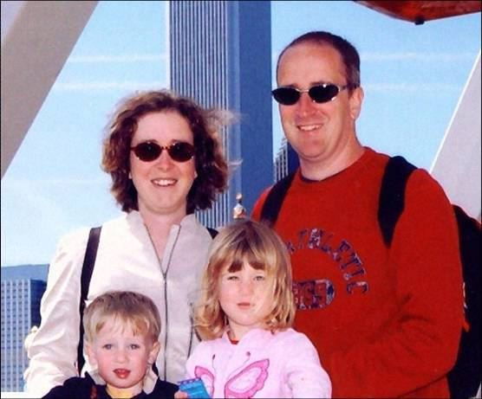


Elaine Bromiley
Videos:
Re-enactment:
https://www.youtube.com/watch?v=6qKYRDxwQf8
Martin Bromiley’s account:
https://www.youtube.com/watch?v=VndU2zap_Rg

Slide 6
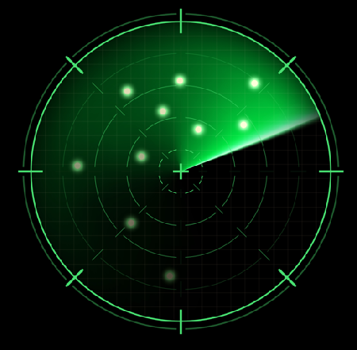
Situational Awareness (SA)
Situation: set of environmental conditions/system states
Elements of a clinical situation
Patient (PMHx, current clinical circumstances)
Environment (physical and human)
Task
Time
Clear knowledge of « what’s going on » and not losing sight of the big picture

Slide 7

Situational Awareness
One of the most critical non-technical skills in healthcare
Central to safe/effective decision-making
Impacted by
Fatigue, stress, cognitive overload
Distractions, Interruptions
Knowledge gaps, cognitive/attentional biases
Loss of SA = unconscious process
Notes:
Use analogy of driving a car

Slide 8

SA Components (G-U-T)
Getting information
Scan/search, pay attention, remain watchful
Communicate information to peers
Understanding the information
Compare with expectations
Check accuracy/completeness of info
Diagnose/interpret the situation
Think ahead (applying the understanding)
Anticipate possible outcomes and take necessary actions
Notes:
Info: chart, monitors, what’s happening over the drapes, noises or lack of noise (sudden quiet)
Understanding: pattern recognition from experience

Slide 9
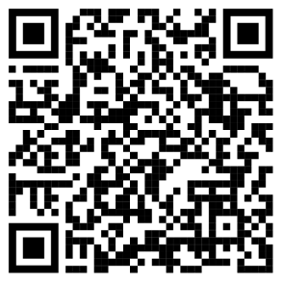
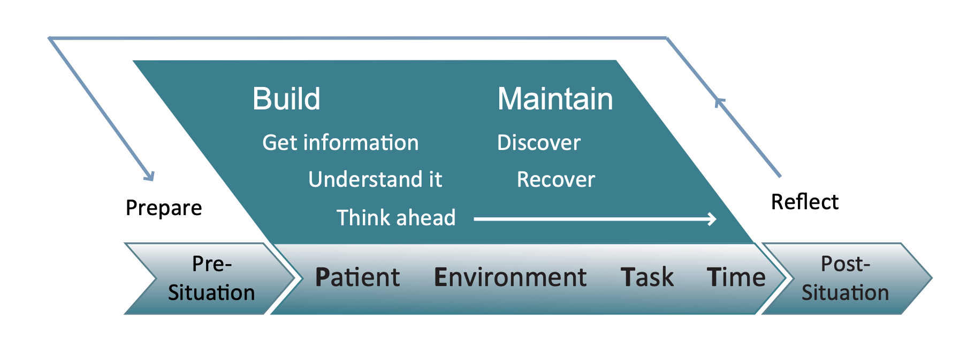
Situational Awareness is a Process

Slide 10

Situational Awareness in Action
Preop assessment
Thorough chart review (Preop ROS, surgeon’s notes, investns)
OR Coordinator role
Continuous info gathering!
Ongoing communication with RN Manager
Tracking dept members’ activities
Tracking surgical case progress/delays
New job site visit
Asking ++ questions

Slide 11

Evolution of Situational Awareness
SA CAN be taught, enhanced over time
Medical student to resident to junior staff to seasoned staff
Impact of site changes
Available resources (equip/meds/blood/consultants/ICU)?
Knowledge of skill set of other team members?
Insight re surgical colleagues?

Slide 12

Team Situational Awareness
SA concept relates to individuals AND teams
Team SA = collective info gathering and interpretation of evolving situation
Requires
Knowledge of team tasks, training
Understanding of roles, responsibilities
Team members that have your back
Members knowing they can lose SA and welcome others’ input
Psychological safety

Slide 13

Successful, Highly Effective Teams
Common, clearly defined purpose
Set and measured goals
Effective leadership
Good communication between members
Free to ask questions, share ideas
Mutual respect
Safe to speak up (psychological safety, trust)
Mickan SM, Rodger SA. Effective health care teams: a model of six characteristics developed from shared perceptions. Journal of Interprofessional Care, 2005, 19(4):358–370

Slide 14

Benefits of being in a good team
In centres where staff perceived themselves being in a good team
Improved staff satisfaction
Improved staff performance
Better staff (reported) health
Reduced patient complaints
Reduced hospital standardized mortality rates!
https://www.kingsfund.org.uk/sites/default/files/employee-engagement-nhs-performance-west-dawson-leadership-review2012-paper.pdf

Slide 15
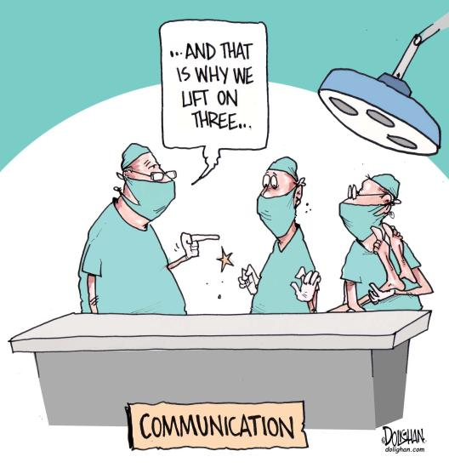
Communication
Sharing of situational awareness
Or lack of awareness!
Formalized/structure SA sharing
SSCL
Pre-block checklist
Handover
Team debriefs
Poor communication leads to patient HARM
Courtesy of Dolighan.com

Slide 16

Personal/Team Debriefing
What did I/we do well?
What could I/we do differently next time?
Are there issues to address?
Knowledge/information gaps?
Communication lapses?
Systemic issues?
Path to building experience…

Slide 17

Situational Awareness Lapses
OR coordinator in noisy OR
cannot hear overhead trauma/stroke codes
Challenging induction
High cognitive load, noisy OR, unable to hear monitors
Laryngospasm on emergence
Team not paying attention, no help unless you point out emergency
Others?

Slide 18

Incivility
Rude, unsociable speech or behaviour
As interpreted by the recipient
Deliverer’s intent not relevant
Reduces cognitive bandwidth, focus
Leads to patient harm
Impact of incivility unnoticed
Recipient unaware of reduced performance

Slide 19
Examples
Anesthesiologist rude when surgeon asks about BP
Anesthesia resident is condescending and dismissive to RN when they phone about a medication sensitivity
Negative experience impacts future behaviours
Failure to speak up (avoidance response) can generalize to others (not just original with offender)

Slide 20
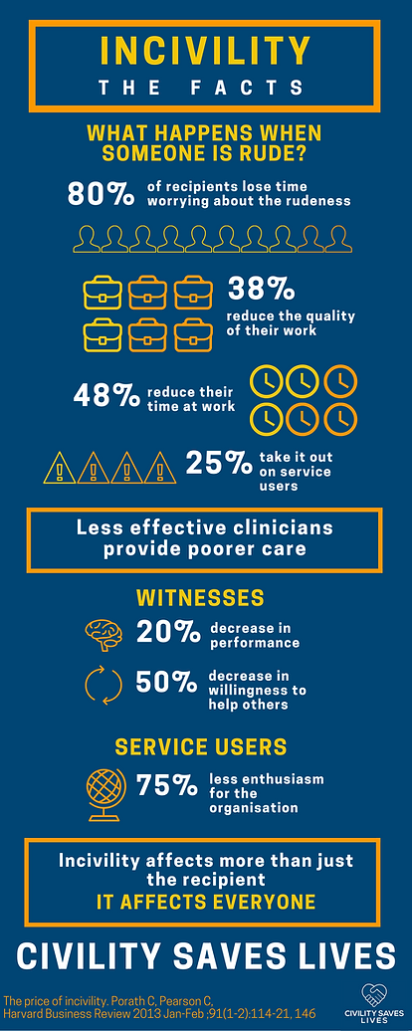

Slide 21

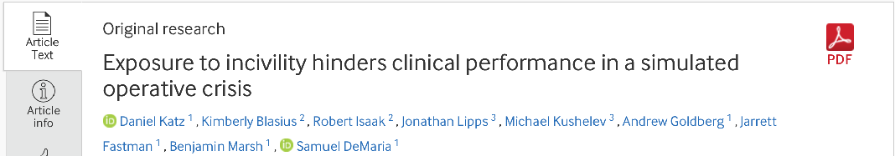
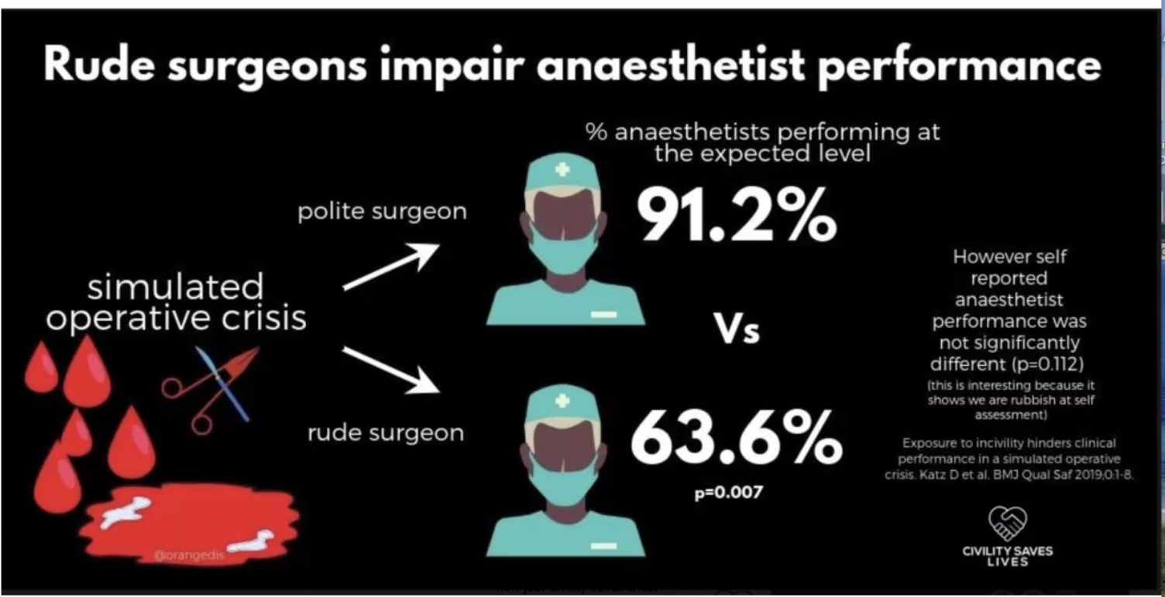

Slide 22

civilitysaveslives.com

Slide 23

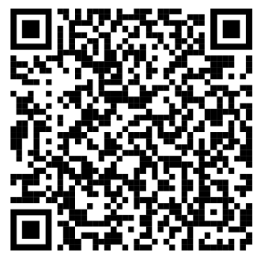
Disruptive Behaviour
Most hospitals now have Code of Conduct Policies
2016: Bill 132 (Ontario)
Legislation requiring workplace program
Amendment of Occupational Health and Safety Act
Increased accountability for employers
Increasing recognition that:
Not only bad for colleagues, bad for patients

Slide 24
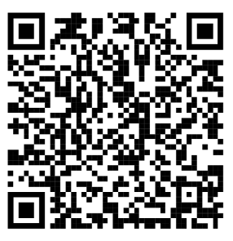

References
Royal College
https://www.royalcollege.ca/en/search.html?fulltext=&format=powerpoint&type=document
CMPA
https://www.cmpa-acpm.ca/en/education-events/good-practices/physician-team/situational-awareness
civilitysaveslives.com
Uncredited images
Freepik.com

Slide 25
The End!

Slide 26
This work is licensed under CC BY-NC-SA 4.0. To view a copy of this license, visit: https://creativecommons.org/licenses/by-nc-sa/4.0/

